Slide 1
Shakespeare's Places
Poi – Avveduto, Cecire, Cinquetti

Slide 2
The project
POI - Shakespeare's Places is a Single page web application that connects ten famous Shakespeare’s plays to real-world locations.
It was made following the Component-Based Architecture.

Slide 3
What is a web application?
A web application is a software (a computer program that has some inputs and some outputs) that can be accessed via web.
A user, using a browser, sends a request to a web server (a computer that offers services to other computers) that processes the request and sends back a response. The response contains an HTML file that is processed by the browser and then displayed on screen. The HTML file can have CSS, a specific code to change the graphical style and JavaScript code to let the user interact with the page
The application which runs in the user’s browser can itself connect to other servers that offers various types of services (maps, storage, etc…).
A web application is made of two parts:
One running on the server, that processes data sent to it.
One running on the client (user’s device), that interacts with the user and let him communicate with the server.

Slide 4
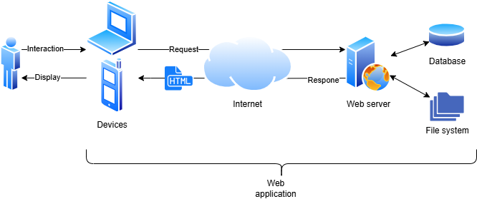
Web application schema

Slide 5
What is a SPA (Single Page Application)
A SPA is a web application, written in the JavaScript language, which is made by a single HTML file that contains many «logical pages» (which in the traditional way of making websites should be in separate HTML files) shown one at a time via code.
With this type of applications the loading of the page is immediate, because the request of the HTML file to the server is made only once (and not every time a link is clicked, like in the traditional way). The user has the perception of using a local application and the use of internet connection is limited to data exchange with servers.

Slide 6
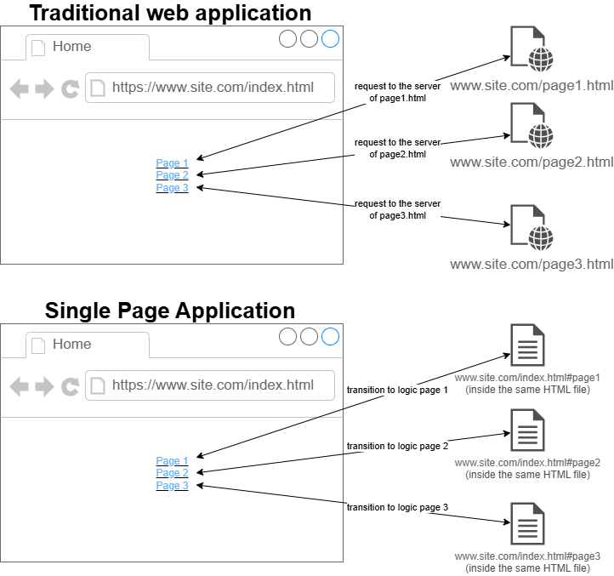
Traditional VS SPA

Slide 7
Component-Based architecture
In medium or large software projects it’s always a best practice divide the development of diffrent feature of the application in many components

